Slide 1
Protecting health policies from the vested interest of the tobacco industry
Emily James
Policy and Campaigns Officer
Jennifer Ruddick
Senior Policy & Campaigns Officer
Action on Smoking and Health
Hilary Wareing
Director
Tobacco Control Collaborating Centre
Deborah Smith
Public Health Specialist
Kent County Council

Slide 2
Objectives
To support councils in producing a clear and comprehensive policy regarding engagement with the tobacco industry.
Outline
WHO FCTC (TCCC)
Protecting policies from the tobacco industry (ASH)
A case study (KCC)
Workshop to identify barriers, opportunities and key actions (All)

Slide 3
Framework Convention on Tobacco Control
World Health Organisation Framework on Tobacco Control http://www.who.int/fctc/en/

Slide 4
What is it?
First international treaty adopted under article 19 of the WHO constitution.
Came into force on the 27th February 2005.
Signed by 168 countries and is legally binding in 180 ratifying countries.

Slide 5
Requirements
Topic Measure Article
Lobbying | Call for a limitation in the interactions between lawmakers and the tobacco industry. | Article 5.3
Demand Reduction | Tax and other measures to reduce tobacco demand. | Article 6 & 7
Passive Smoking | Obligation to protect all people from exposure to tobacco smoke in indoor workplaces, public transport and indoor public places. | Article 8
Regulation | The contents and emissions of tobacco products are to be regulated and ingredients are to be disclosed. | Article 10
Packaging and labelling | Large health warning (at least 30% of the packet cover, 50% or more recommended); deceptive labels ("mild", "light", etc.) are prohibited. | Article 9 & 11
Awareness | Public awareness for the consequences of smoking. | Article 12
Tobacco advertising | Comprehensive ban, unless the national constitution forbids it. | Article 13
Addiction | Addiction and cessation programs. | Article 14
Smuggling | Action is required to eliminate illicit trade of tobacco products. | Article 15
Minors | Restricted sales to minors. | Article 16
Research | Tobacco-related research and information sharing among the parties. | Articles 20, 21, & 22
WHO Framework Convention on Tobacco Control

Slide 6
Article 5.3 of the FCTC states:
“ In setting and implementing their public health policies with respect to tobacco control, parties shall act to protect these policies from commercial and other vested interests of the tobacco industry in accordance with national law”

Slide 7
Article 5.3 of the FCTC states:
Parties (180 countries including the UK) adopted guidelines on the implementation of Article 5.3 in November 2008.
“The guidelines are applicable to government officials, representatives and employees of any national, state, provincial, municipal, local or other public or semi/quasi public institution or body within the jurisdiction of a Party, and to any person acting on their behalf. Any government branch (executive, legislative and judiciary) responsible for setting and implementing tobacco control policies and for protecting those policies against tobacco industry interests should be accountable”.

Slide 8
Guiding Principles
Principle 1: There is a fundamental and irreconcilable conflict between the tobacco industry’s interests and public health policy interests.
The tobacco industry produces and promotes a product that has been proven scientifically to be addictive, to cause disease and death and to give rise to a variety of social ills, including increased poverty. Therefore, Parties should protect the formulation and implementation of public health policies for tobacco control from the tobacco industry to the greatest extent possible.
Principle 2: Parties, when dealing with the tobacco industry or those working to further its interests, should be accountable and transparent.
Parties should ensure that any interaction with the tobacco industry on matters related to tobacco control or public health is accountable and transparent.
Principle 3: Parties should require the tobacco industry and those working to further its interests to operate and act in a manner that is accountable and transparent.
The tobacco industry should be required to provide Parties with information for effective implementation of these guidelines.
Principle 4: Because their products are lethal, the tobacco industry should not be granted incentives to establish or run their businesses.
Any preferential treatment of the tobacco industry would be in conflict with tobacco control policy.

Slide 9
Recommendations
The following important activities are recommended for addressing tobacco industry interference in public health policies:
Raise awareness about the addictive and harmful nature of tobacco products and about tobacco industry interference with Parties’ tobacco control policies.
Establish measures to limit interactions with the tobacco industry and ensure the transparency of those interactions that occur.
Reject partnerships and non-binding or non enforceable agreements with the tobacco industry.
Avoid conflicts of interest for government officials and employees.

Slide 10
The DH Tobacco Control Plan (2011)
Local authorities are “encouraged to follow the Government’s lead in this area, and take necessary action to protect their tobacco control strategies from vested interests”.
The report goes on to state “while we recognise that there may be legitimate operational reasons for local authorities to deal with the tobacco industry, we would encourage transparency in all dealings”.

Slide 11
Questions?
Has your local authority signed the Local Government Declaration on Tobacco Control?
Does your local authority have a policy in place regarding engagement with the tobacco industry?

Slide 12
Protecting health policies from the Tobacco Industry

Slide 13
Overview
Why?
Why do we need to protect public health policy?
Tobacco industry tactics
How?
The Local Government Declaration
The NHS Statement of Support for Tobacco Industry
Implement a Policy

Slide 14
What is article 5.3
Article 5.3
General Obligations
“In setting and implementing their public health policies with respect to tobacco control, Parties shall act to protect these policies from the commercial and other vested interests of the tobacco industry in accordance with national law.”

Slide 15
Why does local government need to protect public policy?
Smoking is an epidemic created and sustained by the tobacco industry.
The industry has a long record of attempting to influence council policies by:
Attempting to influence the national agenda by influencing local decision makers
Encouraging public health resources to be spent on less effective approaches
Undermining health policy through work to renormalise smoking in council environments

Slide 16
In England they have;
Sponsored schools and museums
Paid for industry branded smoking shelters on council property
Provided staff , funding and sniffer dogs for joint work on illicit tobacco. (Focussed on counterfeit rather than main stream products sold without tax.)
Arranged meetings on local harm reduction policies. For example, Nicoventures, a subsidiary of British American Tobacco, has offered to meet council officers.

Slide 17
Tactics to legitimise the industry
Individuals
Front groups
Corporate Social Responsibility
Working with local organisations

Slide 18
“Former detective chief inspector with the Met Police”

Slide 20
JTI and the Campaign to Protect Rural England
JTI“JTI is delighted to be working with our partners at CPRE to support the Middlewich Clean Team in its efforts to keep the beautiful town of Middlewich tidy!”
CPRE: “With JTI’s direct support, the Middlewich Clean Team can continue its mission to keep the town clean. Now there’s no excuse for the people of Middlewich to be dropping their cigarette butts!”

Slide 21
CLG Select Committee on Litter
“In 2010, JTI sat as a member of the Litter Challenge Group, along with the UK Department for Environment, Food and Rural Affairs (DEFRA), Keep Britain Tidy, CPRE and other business organisations. The group was formed in order to develop a nationwide anti-litter campaign, “Love Where You Live”, which was launched in 2011.”
“JTI has also worked with local authorities and businesses in England and Northern Ireland, and with Keep Britain Tidy and the Campaign to Protect Rural England (CPRE), in order to address the problems associated with litter.”

Slide 22
Industry reacts to the LGD
TMA at CLG Select Committee Inquiry on Litter: “We are having very limited discussion with local authorities because of this guidance… called the Local Government Declaration on Tobacco Control. I have written three times to the LGA. I have yet to receive an acknowledgement in regard to an offer to meet them to discuss that .… what we want to do is talk to local government who won’t talk to us at the moment.”
TMA letter to all councils:

Slide 23
CLG reported to have said:
“Councils should also be working with the tobacco industry to stop cigarette litter – if the industry wants to help, they shouldn’t be turning away their support.”

Slide 24
The Local Government Declaration (LGD)
A statement of a councils commitment to tobacco control
Developed by Newcastle City Council in May 2013.
Endorsed by the Public Health Minister, Chief Medical Officer, PHE, ADPH, FPH, Trading Standards and CIEH.
Since its creation it had been signed by half of all top tier councils.

Slide 25
A strategic commitment to tackling tobacco
Acknowledgment of harm from smoking and its impact on local communities
Part of a national movement of councils making a common commitment – half of top tier councils have signed
Commitment to take action to comply with the WHO Framework Convention on Tobacco Control (specifically article 5.3)

Slide 26
We commit the council to
Protect our work from the commercial and vested interests of the tobacco industry by not accepting any partnerships, payments, gifts and services , monetary or in kind or research funding offered by the industry to officials of employees
Notes:
NOT A POLICY

Slide 27
NHS statement of support
Similar to the LGD but designed for NHS organisations
Endorsed by Public Health Minister, NHS England, CQC, BMA, Royal College of Physicians, ADPH and FPH.
Commits to “Protect work interests of the tobacco industry by not accepting any partnerships, payments, gifts and services, monetary or in kind or research funding offered by the tobacco industry to officials or employees”

Slide 28
Developing a policy on contact with the tobacco industry
Meet with the industry only when necessary.
Publish details of any meetings.
Refuse any funding.
Refuse any partnerships, e.g. around illicit or under age sale.
Refuse to participate in any “corporate social responsibility” activity.
Individuals should declare any tobacco industry funding or support they receive.

Slide 29
Tips for a local policy
1. Review current activities and policies
2. Consult across relevant departments
3. Agree corporate sign off
4. Political sign off
5. Implementing and communicating the policy
6. Evaluation and review

Slide 30
Why do we need a policy now..?
The TI is using sophisticated routes to influence policy
Objectives of the industry are apparent (via the TMA - illicit, under age sale of cigarettes)
Local Government is responsible for Public Health
Tobacco Harm Reduction: electronic cigarettes

Slide 31
FCTC Article 5.3
Making it Happen in Kent

Slide 32
About Kent
Kent County Council - Two-tier Authority
12 District Councils
7 Clinical Commissioning Groups
1 Unitary Authority
Population 1.5 million (51% F, 49% M)
309 parishes
283 electoral wards
73% population live in urban areas which make up 22% of the land

Slide 33
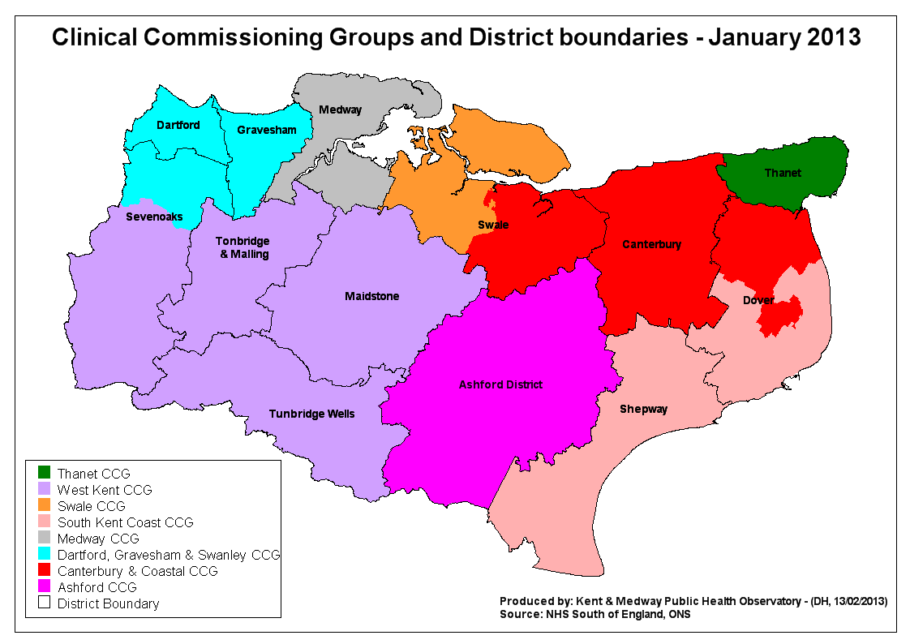

Slide 34
Kent’s understanding of Article 5.3
Framework Convention on Tobacco Control – international treaty negotiated by WHO
Article 5.3 of the Treaty aims to protect public health policies from commercial and other vested interests of the tobacco industry
Treaty set up in recognition of the variety of ways the Tobacco Industry has attempted to influence health policies

Slide 35
Local Government Declaration on Tobacco Control: What are we signing up to?
Act at a local level to reduce smoking prevalence…
Develop plans with our partners…..
Participate in local and regional networks for support..
Support the government in taking action…….
? Protect our tobacco control work from the commercial and vested interests of the tobacco industry by not accepting any partnerships, payments, gifts and services, monetary or in kind or research funding offered by the tobacco industry to officials and employees
Monitor the progress of our plans…..
Publicly declare our commitment to reducing smoking…

Slide 36
Why we should do this: Internal Discussions
Challenge ourselves on the Local Government Declaration commitments
Q: What evidence do we have that we are protecting our tobacco control work..?
A: Implementing Article 5.3 would provide the evidence whilst ensuring best practice
Fulfil legal FCTC responsibility as a Local Authority
For Kent, it is not about no contact with industry, but ensuring openness and transparency where there is necessary contact with the Tobacco Industry

Slide 37
AUDIT OF CURRENT PRACTICE
TO PROTECT PUBLIC HEALTH POLICIES FROM TOBACCO INDUSTRY VESTED INTERESTS IN KENT

Slide 38
Methodology of work
The initial phase of the work included on-site interviews with selected departments key employees and key members,
mapping departments and activities that fall under the remit of Article 5.3
and a review and analysis of the most relevant existing policies and activities for compliance with the article 5.3 and its guidelines.
It was conducted between 5th and 12th January 2015.

Slide 39
Key Departments
Human Resources
Media, Communications, Campaigns and Events
Procurement
Commissioning and Contracting
Cabinet Members
Policy Unit
Public Health
Trading Standards

Slide 40
Documents reviewed
Code of Conduct issued by HR
Anti-Fraud and Corruption strategy,
Council Financial Regulations,
Expenses guidance , policy and procedure,
Corporate grant procedures relating to the receipting and awarding of grants
Drugs and alcohol policy,
Kent Joint Health and wellbeing strategy
The Constitution of the Council,
Information & Data
The Code of Recommended Practice for Local Authorities on Data Transparency,
Whistle Blowing Policy,
Member & Officer Registers of personal interests

Slide 41
Summary findings
“KCC is clearly committed to progress with 5.3 implementation this work”
There are no major obstacles
Overt major tobacco industry interference or activity has not been found
There may be covert tobacco industry interference that is not yet been identified

Slide 42
Summary findings
KCC council employees and Members are not currently adequately knowledgeable nor equipped to identify tobacco industry interference
Trading standards need particular attention as more vulnerable to tobacco industry interference
A major effort should be undertaken to raise awareness of the FCTC obligations, article 5.3 and its guidelines, tobacco industry tactics and strategies

Slide 43
Summary findings
A number of useful policies, instruments, guidance and systems are already in place which could help with the implementation of article 5.3
Given the lack of specific reference to the tobacco industry in these tools different options need to be considered on the best way forward to implement recommendations (either through a single policy covering all aspects or revision of existing instruments, policies, systems)

Slide 44
Next Steps
Developed strategy with focus on:
Raising awareness of responsibilities under Article 5.3 for staff and members (public facing)
Developing simple tools and systems (guidance, reporting tools, focal point for information sharing)
Revising/amending existing policy, codes, strategies
Strategy for Trading Standards practice

Slide 45
Audit
Assessment
Recommendations
Article 5.3
Implementation Plan
Awareness Raising Briefing Paper
For Staff
For Members
[fit for] Public
Trading Standards
Existing Plans
Kent Code: Sponsorship policy /
Whistle-Blowers
Declaration/Conflict of Interest
Procedure
Process for recording
Providing Advice to staff/teams
Ensuring Transparency
Campaigns
Commissioning & Procurement

Slide 46
Governance
Proposed Governance Arrangements
Report on Declaration/Conflict of Interest
Report to Corporate Management Team
Report to Kent Tobacco Control Alliance
Internal Audit in 1 year
Lead Officer appointed

Slide 47
Over to You!
Do You Need A Policy?
Yes?
No?
Why?

Slide 48
Over to You!
What are your key Barriers?
Who are Your Key Facilitators?

Slide 49
AUDIT
Who are your key Stakehodlers?
What are your key Policies?

Slide 50
Actions
Actions For ASH
Actions for YOU
Actions for OTHERS

